Slide 1
Model uncertainty
Investigate:
Is the model sufficiently good?
Can the model be improved?

Slide 2
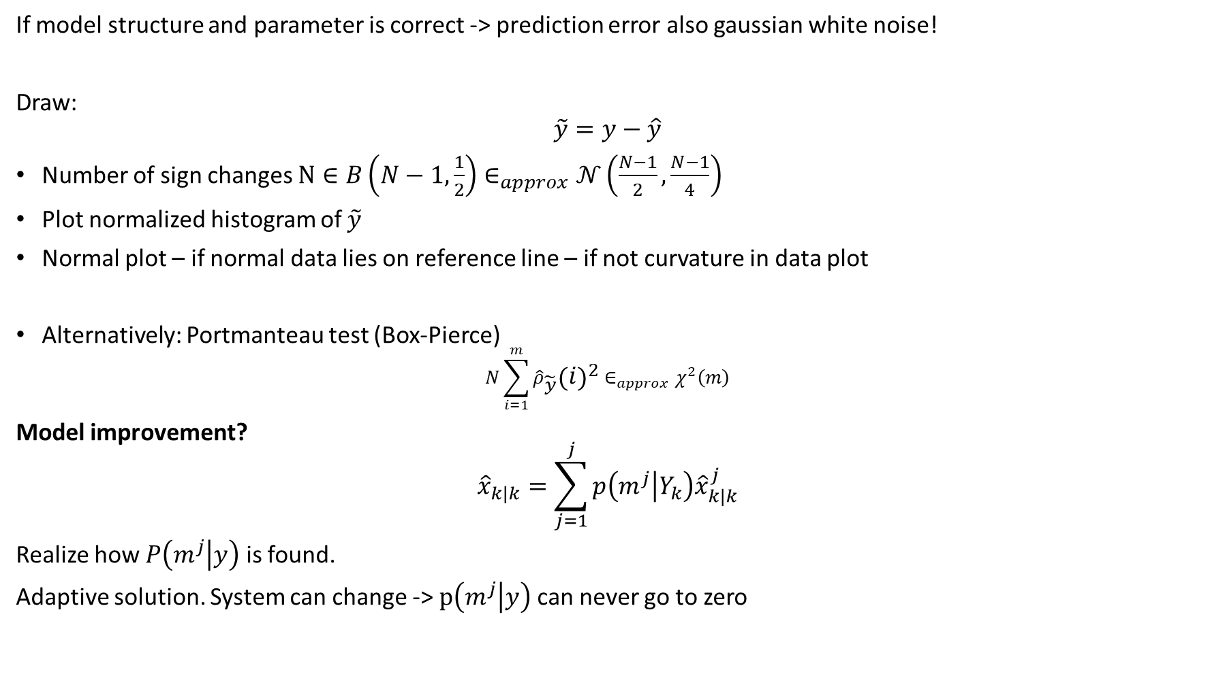
If model structure and parameter is correct -> prediction error also gaussian white noise!
Draw:
$$\tilde{y}=y−\hat{y}$$
Number of sign changes $N∈B\left(N−1,\frac{1}{2}\right)∈_{approx}𝒩\left(\frac{N−1}{2},\frac{N−1}{4}\right)$
Plot normalized histogram of $\tilde{y}$
Normal plot – if normal data lies on reference line – if not curvature in data plot
Alternatively: Portmanteau test (Box-Pierce)
$$N\sum_{i=1}^{m}{{\hat{ρ}}_{\tilde{y}}{\left(i\right)}^{2}}∈_{approx}χ^{2}\left(m\right)$$
Model improvement?
$${\hat{x}}_{k|k}=\sum_{j=1}^{j}{p\left(m^{j} | Y_{k}\right){\hat{x}}_{k|k}^{j}}$$
Realize how $P\left(m^{j} | y\right)$ is found.
Adaptive solution. System can change -> $p\left(m^{j} | y\right)$can never go to zero

Slide 3
Normal Plot
Normal plot of residuals to judge departure from normality Compares the distribution of data to a normal distribution

Slide 4
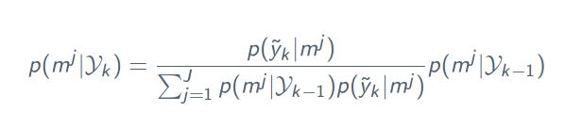
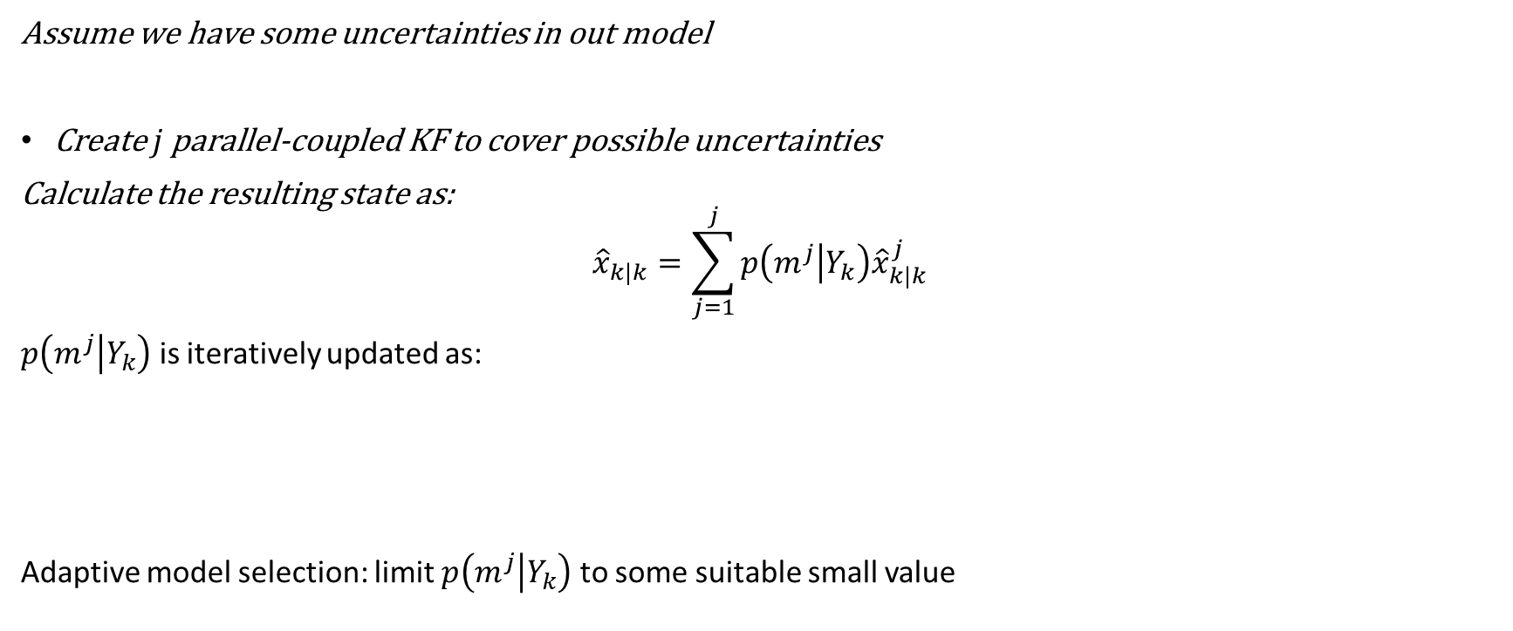
Multi-model State estimation
Assume we have some uncertainties in out model
Create $j$ parallel-coupled KF to cover possible uncertainties
Calculate the resulting state as:
$${\hat{x}}_{k|k}=\sum_{j=1}^{j}{p\left(m^{j} | Y_{k}\right){\hat{x}}_{k|k}^{j}}$$
$p\left(m^{j} | Y_{k}\right)$ is iteratively updated as:
Adaptive model selection: limit $p\left(m^{j} | Y_{k}\right)$ to some suitable small value

